Slide 1
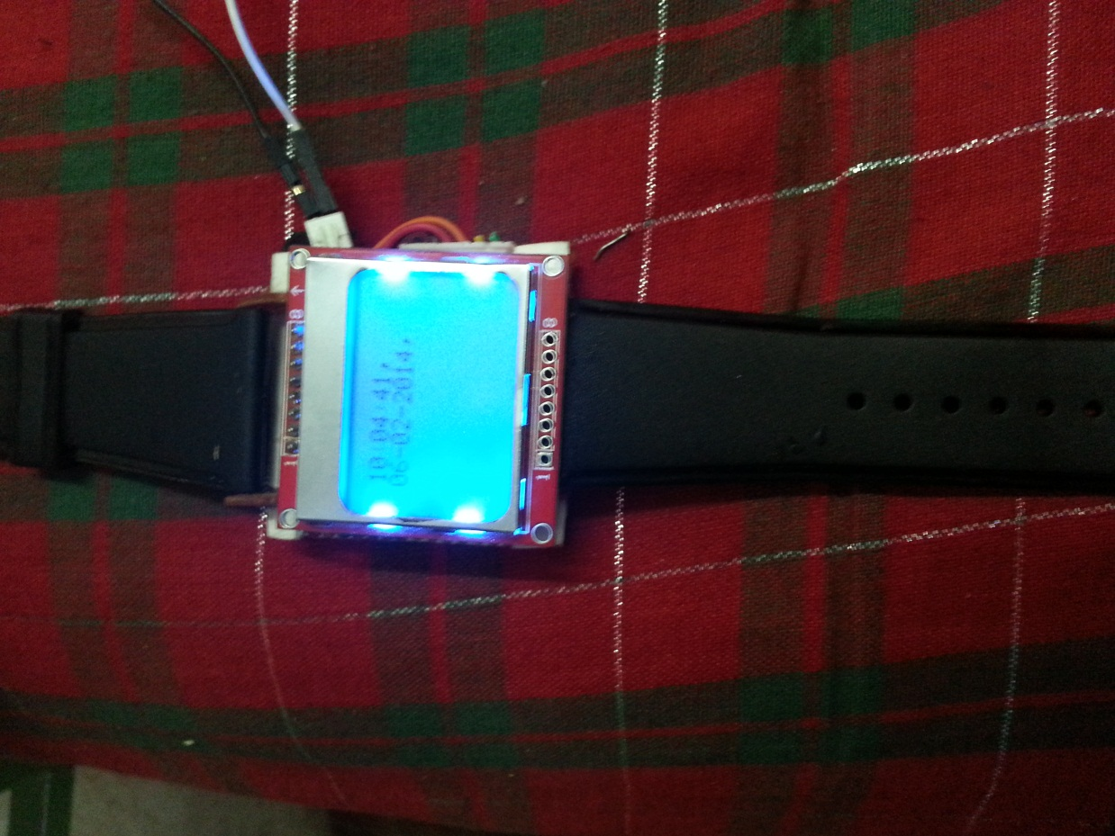
SMART WATCH

Slide 2
Project description
This project is about a multipurpose smart watch. Apart from its conventional usage of showing the time, the watch also displays messages and missed calls which are received by our mobile phone.

Slide 3
Project Working
The various materials used are: nokia 5110 lcd, msp430, bluetooth module, cells.
A message is received by our mobile phones or we miss a call.
Using an app which is developed by us we send the number and the message received character by character to the msp430 present on the watch using bluetooth.
The message received is reassembled into words and the message received along with the number is displayed on the lcd screen.
The watch constantly shows the time by updating the internal timers of the msp430.

Slide 4
Block Diagram
A message is received on the user’s mobile or a call is missed by the user
In the case of a message received the number of the sender and the message contents are sent char by char via bluetooth using an app designed by us. In case of a missed call the number of the person is sent.
The message and number is received by the msp430 and it reassembles the words and displays it on a nokia 5110 lcd
The original function of the watch which is to show the time is implemented using internal timers of the msp430.

Slide 5
Cost Analysis
The various materials required along with their cost are given below:
Bluetooth module - Rs.600.
Nokia 5100 lcd - Rs.300
Cells for supplying power - Rs.300
Msp430- Rs.50
Fabrication- Rs. 100
The overall cost is:1350
Apart from all this we require an android phone with the app designed by us installed in it.

Slide 6
Special features of this watch:
This smart watch is similar to the Samsung note 3 gear, which pairs only with Samsung note 3. But the smart watch can pair via bluetooth to any android mobile which has the specific app developed by us installed in it.
The smart watch is very economical as can be seen from the cost analysis.

Slide 7
Future Scope:
Implementing display of missed calls, news feeds and notifications from several apps such as whatsapp, viber etc.
Implementing Home Automation using smart watch- The nokia lcd can be replaced by a touch screen and options on the screen can be used to control the lights, fans of our house.
Attaching a heart rate sensor and temperature sensor on the smart watch in order to measure our pulse and also display the room temperature on the display screen.

Slide 8
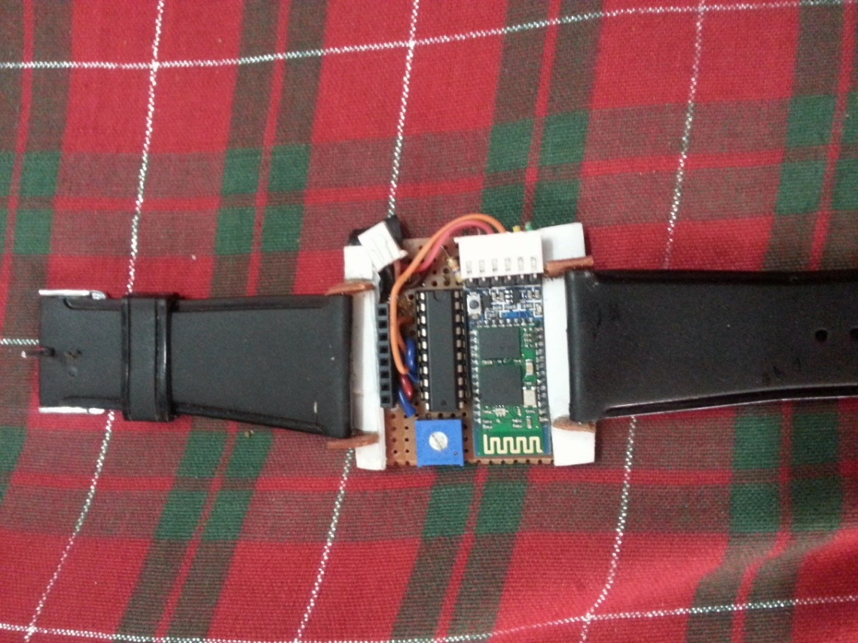
THANK YOU

